Slide 1
Chapter 2: Data and Knowledge Management
ILO BE – Management Information System
Prof. Rina Bora
Assistant Professor
Dept. of Computer Engineering,
SIES Graduate School of Technology
1

Slide 2
Module 2
Data and Knowledge Management: Database Approach, Big Data, Data warehouse and Data Marts, Knowledge Management
Business intelligence (BI): Managers and Decision Making, BI for Data analysis and Presenting Results
1. Kelly Rainer, Brad Prince, Management Information Systems, Wiley
2

Slide 3
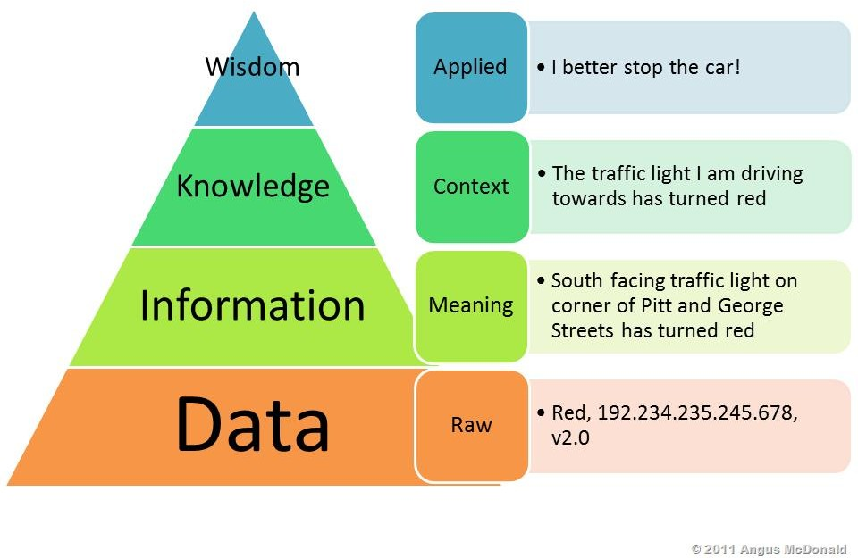
Introduction
Information and Knowledge are invaluable organizational resources as they
provide with a competitive advantage.
3

Slide 4
Managing Data
All IT applications require High Quality Data.
Data to be Accurate, Complete, Timely, Consistent, Accessible, Relevant, and Concise.
The process of acquiring, keeping, and managing data is becoming increasingly difficult.
4

Slide 5
Managing Data
The Difficulties of Managing Data
The amount of data increases exponentially with time.(Walmart have to
manage petabytes of data)
Data are also scattered throughout organizations, and they are collected by many individuals using various methods and devices. These data are frequently stored in numerous servers and locations and in different computing systems, databases, formats, and human and computer languages.
Data are generated from multiple sources.(Internal, External, Personal)
Data also come from the Web, in the form of clickstream data. Clickstream data are those data that visitors and customers produce when they visit a Web site and click on hyperlinks. Clickstream data provide a trail of the users’ activities in the Web site, including user behavior and browsing patterns.
5

Slide 6
Managing Data
The Difficulties of Managing Data
New sources of data, such as blogs, podcasts, videocasts, and RFID tags and other wireless sensors, are constantly being developed.
Data degrade over time. For example, customers move to new addresses or change their names, companies go out of business or are bought, new products are developed, employees are hired or fired, and companies expand into new countries.
Data rot- Data rot refers primarily to problems with the media on which the data are stored.
Over time, temperature, humidity, and exposure to light- Cause physical problems with storage media & its difficult to access the data.
Finding the machines needed to access the data can be difficult.
6

Slide 7
Managing Data
The Difficulties of Managing Data
Data security, quality, and integrity are critical. Legal requirements relating to data differ among countries as well as among industries, and they change frequently.
Inconsistent data within the enterprise.- it prevents a company from developing a unified view of core business information.
Federal regulations—for example, the Sarbanes–Oxley Act of 2002- have made it a top priority for companies to better account for how they are managing information.
Unstructured Data
Big Data
7

Slide 8
Data Governance
An approach to managing information across an entire organization.
The organization follows unambiguous rules for creating, collecting, handling, and protecting its information.
The objective is to make information available, transparent, and useful for the people who are authorized to access it, from the moment it enters an organization until it is outdated and deleted.
8

Slide 9
Data Governance
Strategies for implementing Data Governance
Master Data Management is a process that spans all organizational business processes and applications. It provides companies with the ability to store, maintain, exchange, and synchronize a consistent, accurate, and timely “single version of the truth” for the company’s master data.
Master data - set of core data, such as customer, product, employee, vendor, geographic location, and so on, that span the enterprise information systems.
Transaction data - generated and captured by operational systems, describe the business’s activities, or transactions.
9

Slide 10
Data Governance
Strategies for implementing Data Governance
Master data are applied to multiple transactions and are used to categorize,
aggregate, and evaluate the transaction data.
Mary Jones purchase one Samsung 42-inch plasma television, part number 1234, from Bill Roberts at Best Buy, for $2,000, on April 20, 2015. In this example, the master data are “product sold,” “vendor,” “salesperson,” “store,” “part number,” “purchase price,” and “date.” When specific values are applied to the master data, then a transaction is represented. Therefore, transaction data would be, respectively, “42-inch plasma television,” “Samsung,” “Best Buy,” “Bill Roberts,” “1234,” “$2,000,” and “April 20, 2015.”
10

Slide 11
The Database Approach
From the mid-1950s till early1970s, organizations managed their data in a file management environment.
The automated systems developed independently from one another, without any overall planning. Each application required its own data, which were organized in a Data File.
Data File is a collection of logically related records. In a file management environment, each application has a specific data file related to it.
Databases are arranged so that the Database Management System provides all users with access to all of the data.
11

Slide 12
The Database Approach
Database Management Systems minimize the following problems:
Data redundancy: The same data are stored in multiple locations.
Data isolation: Applications cannot access data associated with other
applications.
Data inconsistency: Various copies of the data do not agree.
Database Management Systems maximize the following:
Data security: Databases must have extremely high security measures.
Data integrity: Data meet certain constraints; for example, there are no alphabetic characters in a Aadhaar No.
Data independence: Applications and data are independent of one
another; so all applications are able to access the same data.
12

Slide 13
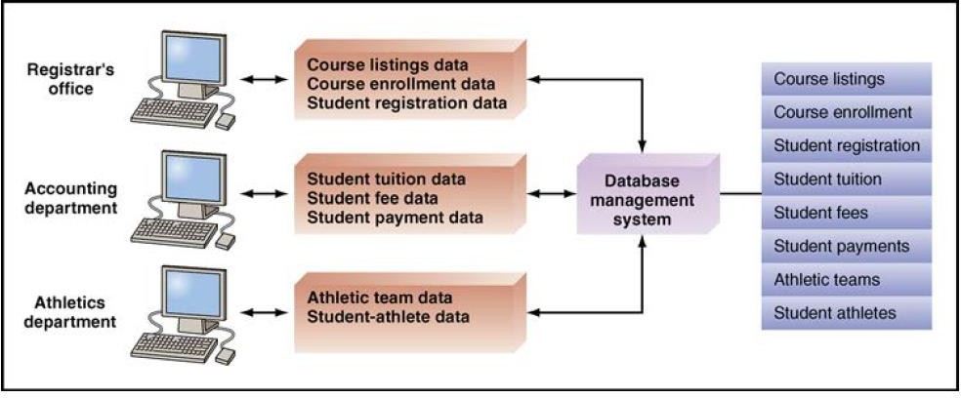
The Database Approach
- Database Management Systems
Figure: Database management system.
13

Slide 14
The Data Hierarchy
Data are organized in a hierarchy that begins with bits and proceeds all the way to databases.
Bit
Byte
Word
Field
Record
Data File / Table
14

Slide 15
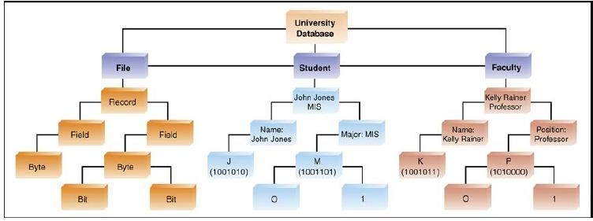
The Data Hierarchy
Figure: Hierarchy of data for a computer-based file
15

Slide 16
The Relational Database Model
Database Management system (DBMS)
It is a set of programs that provide users with tools to create and manage a
database.
Managing a database : adding, deleting, accessing, modifying, and analyzing data stored in a database.
An organization can access the data by using query and reporting tools that are part of the DBMS or by using application programs specifically written to perform this function.
Provide the mechanisms for maintaining the integrity of data, managing security and user access, and recovering information if the system fails.
Must be carefully managed.
16

Slide 17
The Relational Database Model
Database Management system (DBMS)
Relational database model - popular and easy to use.
Popular examples of relational databases are Microsoft Access and Oracle.
Other database models (like the hierarchical and network models) are not used by organizational employees.
Most business data traditionally were organized into simple tables consisting of columns and rows.
Tables allow people to compare information quickly by row or column.
Users can retrieve items rather easily by locating the point of intersection of a particular row and column.
17

Slide 18
The Relational Database Model
Database Management system (DBMS)
The relational database model is based on the concept of two-dimensional
tables.
A relational database is usually designed with a number of related tables.
Each of these tables contains records (listed in rows) and attributes (listed
in columns).
18

Slide 19
The Relational Database Model
Data Model
A diagram that represents entities in the database and their relationships.
An entity is a person, place, thing, or event about which information is maintained.
A record generally describes an entity.
An instance of an entity refers to each row in a relational table, which is a specific, unique representation of the entity.
An attribute is each characteristic or quality of a particular entity.
19

Slide 20
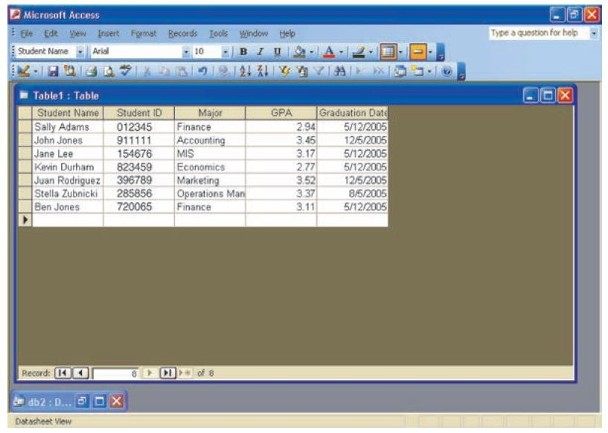
The Relational Database Model
Student Database
Figure: Student database example
20

Slide 21
The Relational Database Model
Database Management system (DBMS)
Primary Key -One field that uniquely identifies that record so that it can
be retrieved, updated, and sorted.
Secondary key is another field that has some identifying information, but typically does not identify the record with complete accuracy.
Foreign key is a field (or group of fields) in one table that uniquely identifies a row of another table. A foreign key is used to establish and enforce a link between two tables.
21

Slide 22
Big Data
Introduction
According to IDC (International Data Corporation) , the world generates exabytes of data each year (an exabyte is 1 trillion terabytes).
By 2000, only 25% of the stored information in the world was digital.
By 2015, the stored information in the world was over 98%.
Big Data is a collection of data so large and complex that it is difficult to manage using traditional database management systems.
Big Data is about predictions.
Eg. The likelihood that an e-mail message is spam.
22

Slide 23
Video to explain Big Data
Introduction to Big Data
23

Slide 24
Big Data
Definition
Gartner (www.gartner.com) defines Big Data as diverse, high-volume, high velocity information assets that require new forms of processing to enable enhanced decision making, insight discovery, and process optimization.
24

Slide 25
Big Data
Definition
Second The Big Data Institute (TBDI:https://thebigdatainstitute.wordpress.com/)
defines Big Data as vast datasets that:
Exhibit variety; Include structured, unstructured, and semi-structured data;
Are generated at high velocity with an uncertain pattern;
Do not fit neatly into traditional, structured, relational databases; and
Can be captured, processed, transformed, and analyzed in a reasonable amount of time only by sophisticated information systems.
25

Slide 26
Big Data
Comprises of
Traditional enterprise data - examples are customer information from customer relationship management systems, transactional enterprise resource planning data, Web store transactions, operations data, and general ledger data.
Machine-generated/sensor data - examples are smart meters; manufacturing sensors; sensors integrated into smartphones, automobiles, airplane engines, and industrial machines; equipment logs; and trading systems data.
Social data - examples are customer feedback comments; microblogging sites such as Twitter; and social media sites such as Facebook, YouTube, and LinkedIn.
Images captured by billions of devices located throughout the world, from digital cameras and camera phones to medical scanners and security cameras.
26

Slide 27
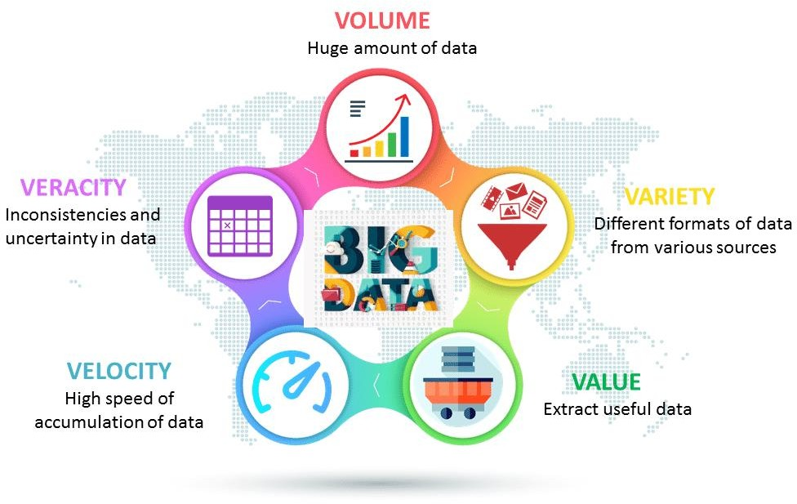
Characteristics of Big Data
https://cdn.datafloq.com/cache/medium/1500x900/vs-2020-04-16-13-53-39.png
27

Slide 28
Big Data
Characteristics of Big Data
Volume — the size and amounts of big data that companies manage and analyze. For instance Sensors in a single jet engine can generate 10 terabytes of data in 30 minutes. With more than 25,000 airline flights per day, the daily volume of data from just this single source is very huge.
Velocity—the speed at which companies receive, store and manage data. The rate of data flow into an organization is rapidly increasing. It increases the speed of the feedback loop between a company, its customers, its suppliers, and its business partners.
Variety—the diversity and range of different data types, including unstructured data, semi-structured data and raw data. Big Data formats change rapidly. They include satellite imagery, broadcast audio streams, digital music files, Web page content, scans of government documents, and comments posted on social networks.
28

Slide 29
Big Data
Characteristics of Big Data
Veracity — It refers to the quality and accuracy of data. Gathered data could have missing pieces, may be inaccurate or may not be able to provide real, valuable insight. Veracity, overall, refers to the level of trust there is in the collected data.
Value— value that big data can provide, and it relates directly to what organizations can do with that collected data.
29

Slide 30
Big Data
Issues with Big Data
Big Data Can Come from Untrusted Sources —How trustworthy are those external sources of data? Eg. Tweet? The data may come from an unverified source. The data itself, can be false or misleading.
Big Data Is Uncleaned—refers to inaccurate, incomplete, incorrect, duplicate, or erroneous data. The company wants to see how often a competitor’s product appears in social media outlets as well as the sentiments associated with those posts.
Big Data Changes, Especially in Data Streams—data itself can change, because the conditions can change. For instance, imagine a utility company that analyzes weather data and smart-meter data to predict customer power usage. What happens when the utility is analyzing this data in real time and it discovers data missing from some of its smart meters?

Slide 31
Big Data
Managing Data
Big Data makes it possible to do many things
Example, to spot business trends more rapidly and accurately, prevent disease, track crime, and so on.
Big Data can reveal valuable patterns and information
Walmart and Google, have been able to process Big Data for years, but only at great expense.
Today’s hardware, cloud computing and open-source software make processing Big Data affordable for most organizations.

Slide 32
Big Data
Steps for Managing Data
Integrate Information silos into a database environment and then to develop data warehouses for decision making.(An information silo is an IS that does not communicate with other, related ISs in an organization)
Business of information management- Oracle, IBM, Microsoft, and SAP have spent billions of dollars purchasing software firms that specialize in data management and business intelligence.
Many organizations employ NoSQL databases to process Big Data. Think of them as “not only SQL”.

Slide 33
Big Data
Steps for Managing Data
Hadoop is a collection of programs that allow storage, retrieval, and analysis of very large datasets using massively parallel processing.
MapReduce is a procedure of dividing an analysis into pieces that can be distributed across different servers in different locations. MapReduce first distributes the analysis (map) and then collects and integrates the results back into one report (reduce).

Slide 34
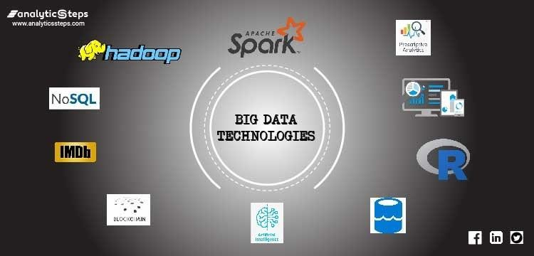
Topmost Big Data technologies in 2020
https://lh6.googleusercontent.com/eRqO69je1stz7kZ8t80h3g1RCIJilmF29Cb-xhMjPJQnf4-
nBQTlpMCuPTPnOE37eYczIfzB9WVvgTb7Kz8YPp-PMOvbnNimLb_eOw0o0BtVb6uxvyz38ENDWGZ_fekuwb8yAmTq

Slide 35
Big Data
Putting Big Data to Use
1. Making Big Data Available - for relevant stakeholders can help organizations gain value. Open data is accessible public data that individuals and organizations can use to create new businesses and solve complex problems. (Govt. Agencies) Public Data Sources by 2018

Slide 36
Big Data
Putting Big Data to Use
2. Enabling Organizations to Conduct Experiments— improve performance by conducting controlled experiments. For example, Amazon (Google/LinkedIn) constantly experiments by offering slight different “looks” on its Web site. These experiments are called A/B experiments, because each experiment has only two possible outcomes.

Slide 37
Big Data
Putting Big Data to Use
3. Micro-Segmentation of Customers – Segmentation of customer means dividing them up into groups that share one or more characteristics. Micro-segmentation simply means dividing customers up into very small groups, or even down to the individual level.
For example, Paytronix Systems (www.paytronix.com)

Slide 38
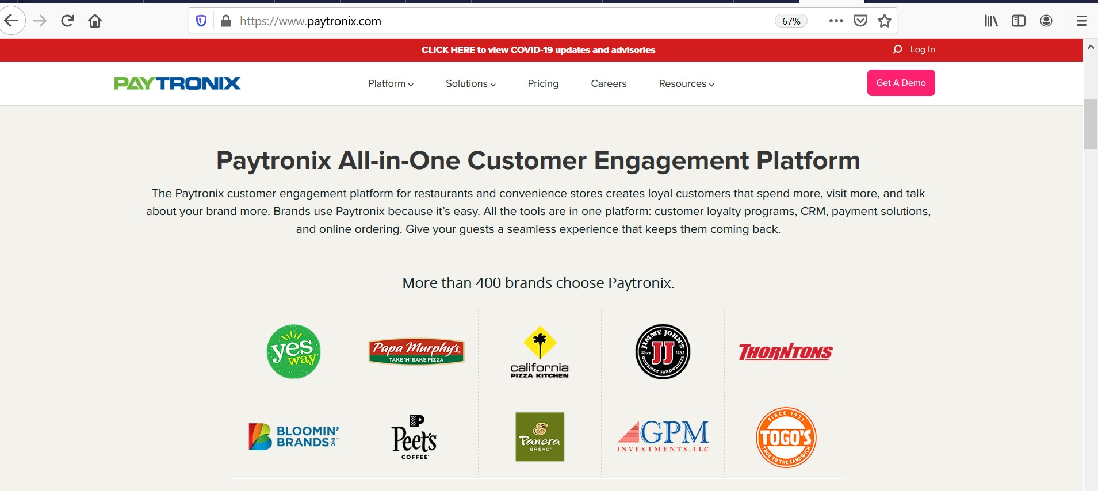

Slide 39
Big Data
Putting Big Data to Use
4. Creating New Business Models.– Companies are able to use Big Data to create new business models. Eg. The secret key driving growth of Uber, is the big data it collects and leverages for insightful and intelligent decision making. Data moves Uber. (surge pricing, better cars, detecting fake rides, fake cards, fake ratings, estimating fares and driver ratings)
Reinvent transportation and logistics globally.

Slide 40
Big Data
Putting Big Data to Use
5. Organizations Can Analyze More Data - organizations can even process all the data relating to a particular phenomenon, meaning that they do not have to rely as much on sampling

Slide 41
Big Data
Big Data Used in the Functional Areas of the Organization
1. Human Resources- Employee benefits, particularly healthcare, represent a major business expense.
Caesars Entertainment (www.caesars.com), for example, analyzes health-insurance claim data for its 65,000 employees and their covered family members. 10,000 emergencies shifted to less-expensive alternatives, for a total savings of $4.5 million.
Catalyst IT Services (www.catalystdevworks.com),a technology outsourcing company that hires teams for programming jobs. The company collects more data based on how candidates answer than on what they answer.
44

Slide 42
Big Data
Big Data Used in the Functional Areas of the Organization
2. Product Development - Big Data can help capture customer preferences and support designing new products.
Ford Motor Company (www.ford.com) was considering a “three blink” turn indicator that had been available on its European cars for years. Unlike the turn signals on its U.S. vehicles, this indicator flashes three times at the driver’s touch and then automatically shuts off.
Ford decided that conducting a full-scale market research test on this blinker would be too costly and time consuming. Instead, it examined auto-enthusiast Web sites and owner forums to discover what drivers were saying about turn indicators. Using text-mining algorithms, researchers culled more than 10,000 mentions and then summarized the most relevant comments.

Slide 43
Big Data
Big Data Used in the Functional Areas of the Organization
3. Operations - For years, companies have been using information technology to make their operations more efficient.
Mr. Sanjay Kharb, VP- Engineering, Ola says “Deriving insights from data is at the heart of everything we do at Ola”. Streamline the frequency of vehicles getting registered on the platform, optimize user-driver search, and accurate and faster location mapping.

Slide 44
Big Data
Big Data Used in the Functional Areas of the Organization
4. Marketing - Marketing managers have used data to better understand their customers and to target their marketing efforts more directly.
Netflix uses big data analytics for targeted advertising.
Coca-Cola uses big data analytics to drive customer retention.
UOB Bank, Singapore uses big data to drive risk management

Slide 45
Big Data
Big Data Used in the Functional Areas of the Organization
5. Government Operations - With 55 percent of the population of the Netherlands living under the threat of flooding, water management is critically important to the Dutch government. The government operates a sophisticated water management system, managing a network of dykes or levees, canals, locks, harbors, dams, rivers etc.
In its water management efforts, the government makes use of a vast number of sensors embedded in every physical structure used for water control. The sensors generate at least 2 petabytes of data annually. sensors in dykes can provide information on the structure of the dyke, how well it is able to handle the stress of the water it controls, and whether it is likely to fail. Further, the sensor data are providing valuable insights for new designs for Dutch dykes. The result is that Dutch authorities have reduced the costs of managing water by 15 percent.

Slide 46
Big Data
Big Data Used in the Functional Areas of the Organization
5. Government Operations -
Indian Government :
Demonetization or introduction of GST, Catch tax evaders in 2017,
GST scheme implemented to know about how the trade is conducted, Geotagging the entire agriculture infrastructure

Slide 47
Data Warehouses and Data Marts
Introduction
- Successful companies are able to respond quickly and flexibly
to market changes and opportunities.

Slide 48
Data Warehouses and Data Marts
Introduction
A Data Warehouse is a repository of historical data that are organized by subject to support decision makers in the organization. Since data warehouses are so expensive, they are used by large companies.
A Data Mart is a low-cost, scaled-down version of a data warehouse that is designed for the end-user needs in a strategic business unit (SBU) or an individual department.

Slide 49
Data Warehouses and Data Marts
Basic Characteristics
Organized by business dimension or subject- Data are organized by subject—for example, by customer, vendor, product, price level, and region.
Use online analytical processing - The objectives are speed and efficiency, which are critical to a successful Internet-based business operation. Online analytical processing involves the analysis of accumulated data by end users.
Integrated - Data are collected from multiple systems and then integrated around subjects. (Customer data)

Slide 50
Data Warehouses and Data Marts
Basic Characteristics
Time Variant – Historical data is maintained over the time period. Organizations utilize historical data to detect deviations, trends, and long- term relationships.
Nonvolatile- Data is retained after power loss, users cannot change or update the data. Warehouses and marts are updated, but through IT- controlled load processes rather than by users.
Multidimensional - Relational databases store data in 2-D tables. In contrast, data warehouses and marts store data in more than 2-D. A common representation for this multidimensional structure is the data cube.

Slide 51
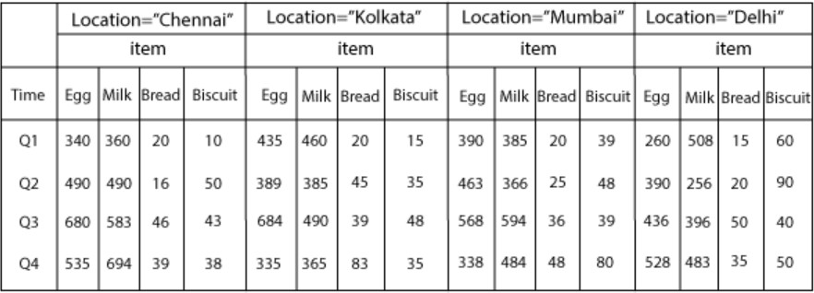
Data Warehouses and Data Marts
Basic Characteristics
6. Multidimensional -
https://static.javatpoint.com/tutorial/datawarehouse/images/data-warehouse-what- is- multi-dimensional-data-model3.png

Slide 52
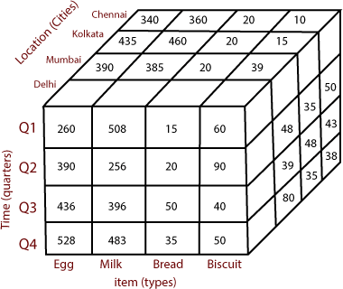
Data Warehouses and Data Marts
Basic Characteristics
6. Multidimensional -
https://static.javatpoint.com/tutorial/datawarehouse/images/data-warehouse-what- is- multi-dimensional-data-model4.png

Slide 53
Data Warehouses and Data Marts
A Generic Data Warehouse Environment
The environment for data warehouses and marts includes the following:
Source systems that provide data to the warehouse or mart.
Data-integration technology and processes that prepare the data for use.
Different architectures for storing data in an organization’s data warehouse or data marts.
Different tools and applications for the variety of users.
Metadata, data-quality, and governance processes that ensure that
the warehouse or mart meets its purposes

Slide 54
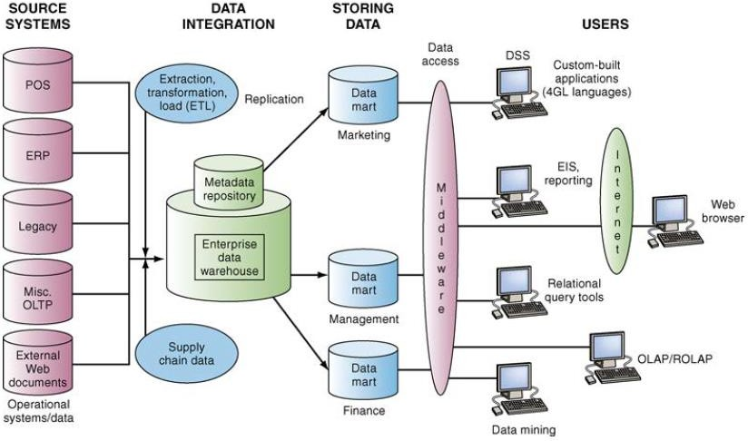
Data Warehouse Framework

Slide 55
Data Warehouse Framework
Source Systems - operational/ transactional systems, enterprise resource planning (ERP) systems, Web site data, third-party data. They use different software packages (e.g., IBM, Oracle) and store data in different formats (e.g., relational, hierarchical).
contain “bad data”, missing or incorrect data.
data-profiling software to be used to understand the data in better way.
multiple systems that contain some of the same data and the best system must be selected as the source system.

Slide 56
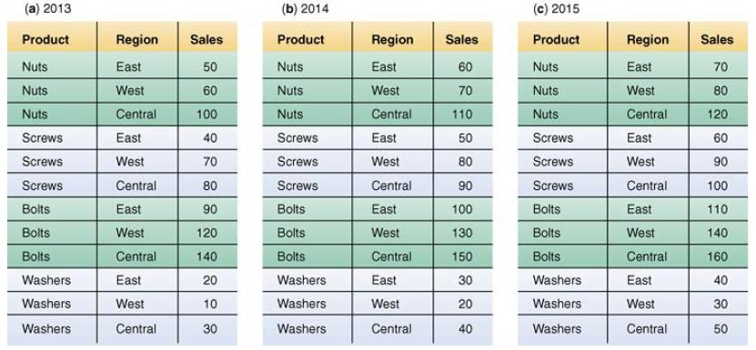
Data Warehouse Framework
Figure: Relational databases

Slide 57
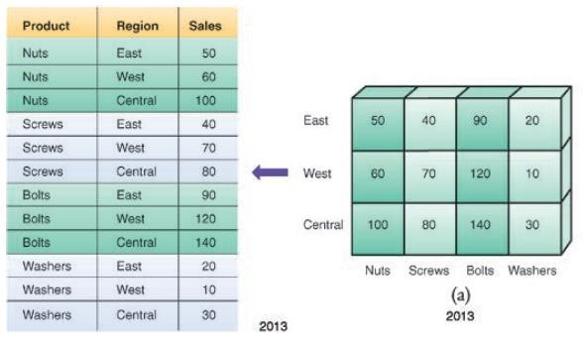
Data Warehouse Framework
Figure: Equivalence between relational and multidimensional databases

Slide 58
Data Warehouse Framework
Data Integration-
organizations need to Extract the data, Transform them, and then Load them into a data mart or warehouse. (ETL).
sometimes, Data are Extracted, Loaded into a mart or warehouse, and then Transformed (ELT).
Data extraction can be performed either by handwritten code (e.g., SQL queries) or by commercial data-integration software.
After the data are extracted, they are transformed to make them more useful.
Finally, data are loaded into the warehouse or mart during a
specific period known as the “load window.”

Slide 59
Data Warehouse Framework
Storing the Data-
A variety of architectures can be used to store decision- support data.
Central enterprise data warehouse, without data marts
Independent data marts(not particularly effective).
Hub and Spoke. (a central data warehouse and multiple dependent data marts that source)

Slide 60
Data Warehouse Framework
Metadata-
Data about the data.
IT personnel need information about data sources; database, table, and column names; refresh schedules; and data-usage measures.
Users’ needs include data definitions, report/query tools, report distribution information, and contact information for the help desk.

Slide 61
Data Warehouse Framework
Data Quality-
The quality of the data in the warehouse must meet users’ needs.
Data can be improved with data-cleansing software.
Long-term solution is to improve the quality at the source system level. To do this, business owners of the data to assume responsibility for making any necessary changes to implement this solution.

Slide 62
Data Warehouse Framework
Governance -
To ensure that BI is meeting their needs, organizations must implement governance to plan and control their BI activities.
Governance requires that people, committees, and processes be in place.
Companies create a senior-level committee comprised of vice presidents and directors who (1) ensure that the business strategies and BI strategies are in alignment, (2) prioritize projects, and (3) allocate resources

Slide 63
Data Warehouse Framework
Users -
Many potential BI users, include IT developers; frontline workers; analysts; information workers; managers and executives; and suppliers, customers, and regulators.
Some of these users are information producers (IT developers and analysts) .
Other users - including managers and executives - are information consumers.

Slide 64
Data Warehouse
Benefits of Data Warehouse
End users can access needed data quickly and easily via Web
browsers because these data are located in one place.
End users can conduct extensive analysis with data in ways that
were not previously possible.
End users can obtain a consolidated view of organizational data.

Slide 65
Knowledge Management
Introduction
Data and information are critically important organizational assets.
Knowledge is a vital asset as well.
Successful managers have always valued and utilized intellectual assets. But they did not ensure that knowledge was shared and dispersed in a way that benefited the overall organization.
Company’s knowledge assets are not housed in relational databases. But they are dispersed in e-mail, word-processing documents, spreadsheets, presentations on individual computers, and in people’s heads.
Extremely difficult for companies to access and integrate this knowledge.
The result frequently is less-effective decision making.

Slide 66
Knowledge Management
Concepts and Definitions
Knowledge management (KM) is a process that helps organizations manipulate important knowledge that comprises part of the organization’s memory, usually in an unstructured format.
Knowledge, as a form of capital, must exist in a format that can be exchanged among persons.
Also, it must be able to grow.

Slide 67
Knowledge Management
Concepts and Definitions
Knowledge. In the context of IT, data are a collection of facts,
measurements, and statistics;
Information is organized or processed data that are timely and
accurate.
Knowledge is information that is contextual, relevant, and useful. Knowledge is information in action. It is also referred as Intellectual capital/ intellectual assets.

Slide 68
Knowledge Management
Concepts and Definitions
Explicit Knowledge-
Deals with more objective, rational, and technical knowledge.
Consists of the policies, procedural guides, reports, products, strategies, goals, core competencies, and IT infrastructure of the enterprise.
Eg : A description of how to process a job application that is documented in a firm’s HR policy manual.

Slide 69
Knowledge Management
Concepts and Definitions
Tacit Knowledge-
It is a cumulative store of subjective or experiential learning.
Consists of an organization’s experiences, insights, expertise, know- how, trade secrets, skill sets, understanding, and learning.
Includes the organizational culture & the organization’s prevailing values.
Generally imprecise and costly to transfer. It is also highly personal.
It is difficult to formalize or codify.
Eg: A salesperson who has worked with particular customers over time and has come to know their needs quite well. it might be
difficult for the salesperson to put into writing.

Slide 70
Knowledge Management
Knowledge Management Systems(KMS)
It refers to the use of modern information technologies—the Internet, intranets, extranets, databases—to systematize, enhance, and expedite intrafirm and interfirm knowledge management.
Help an organization cope with turnover, rapid change, and downsizing by making the expertise of the organization’s human capital widely accessible.
They make best practices, provide improved customer service, more efficient product development, and improved employee morale and retention.

Slide 71
Knowledge Management
Knowledge Management Systems(KMS)
Challenges to Implement
1. Employees must be willing to share their personal tacit knowledge. To encourage this behavior, organizations must create a knowledge management culture that rewards employees who add their expertise to the knowledge base.
2. The organization must continually maintain and upgrade its knowledge base.(incorporate new knowledge and delete old, outdated knowledge)
3. Companies must be willing to invest in the resources needed to carry out these operations

Slide 72
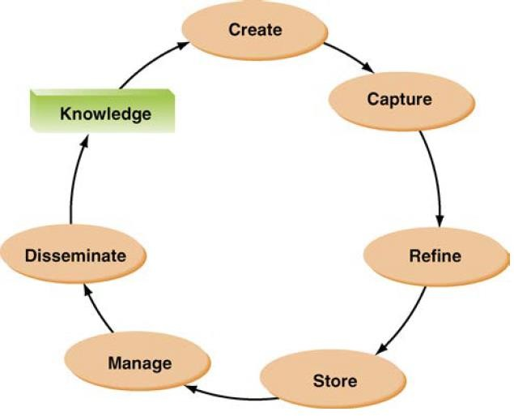
Knowledge Management
Knowledge Management Systems(KMS) Cycle

Slide 73
Knowledge Management
KMS Cycle
Create knowledge. Knowledge is created as people determine new ways of doing things or develop know-how. Sometimes external knowledge is brought in.
Capture knowledge. New knowledge must be identified as valuable and
be represented in a reasonable way.
Refine knowledge. New knowledge must be placed in context so that it is actionable. This is where tacit qualities (human insights) must be captured along with explicit facts.

Slide 74
Knowledge Management
KMS Cycle
Store knowledge. Useful knowledge must then be stored in a reasonable format in a knowledge repository so that other people in the organization can access it.
Manage knowledge. Like a library, the knowledge must be kept current. It
must be reviewed regularly to verify that it is relevant and accurate.
Disseminate knowledge. Knowledge must be made available in a useful format to anyone in the organization who needs it, anywhere and anytime.

Slide 75
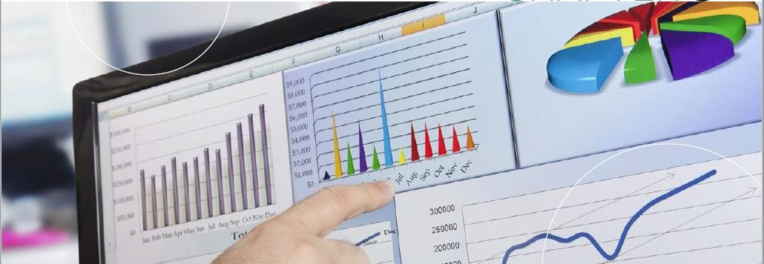
Business Analytics
Introduction
Business Analytics (BA) is the process of developing actionable decisions or recommendations for actions based on insights generated from historical data.

Slide 76
Business Analytics
Introduction
BA examines data with a variety of tools and techniques, formulates descriptive, predictive, and prescriptive models, and communicates these results to organizational decision makers.
BA can answer questions such as: What happened, how many, how often, where the problem is, what actions are needed, why is this happening, what will happen if these trends continue, what will happen next, what is the best (or worst) that can happen, and what actions should the organization take to achieve various successful business outcomes?

Slide 77
Business Intelligence
Introduction
Business intelligence (BI) has been defined as a broad category of applications, technologies, and processes for gathering, storing, accessing, and analyzing data to help business users make better decisions.
Many experts argue that the terms should be used interchangeably.

Slide 78

Managers and Decision Making
Management
Management is a process by which an organization achieves its goals through the use of resources (people, money, materials, and information).
These resources are inputs and achieving the organization’s goals is the output of the process.
Managers oversee this process in an attempt to optimize it. The ratio of input/output is an indication of the organization’s productivity.

Slide 79

Managers and Decision Making
The Manager’s Job and Decision Making
- Managers do many things, depending on their position, the type and
size of the organization, the organization’s policies and culture, and the personalities of the managers themselves. Despite these variations, all managers perform three basic roles.
Interpersonal roles: Figurehead, leader, liaison
Informational roles: Monitor, disseminator, spokesperson, analyzer
Decisional roles: Entrepreneur, disturbance handler, resource allocator, negotiator

Slide 80
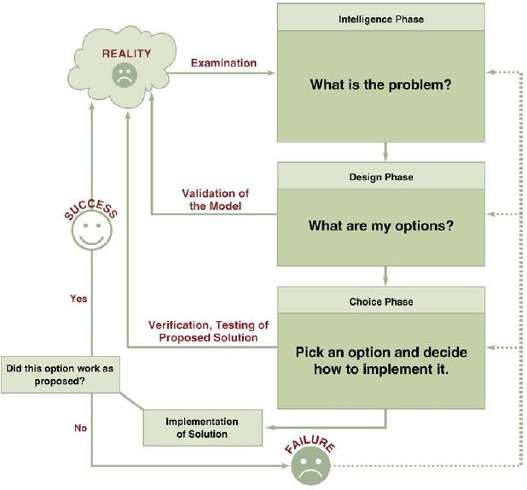
The process and Phases in decision making

Slide 81
The process and Phases in decision making
The decision-making process starts with the intelligence phase, in which managers examine a situation and then identify and define the problem or opportunity.
In the design phase, decision makers construct a model for addressing the situation.
They perform this task by making assumptions that simplify reality and by expressing the relationships among all of the relevant variables.
Managers then validate the model by using test data.
Finally, decision makers set criteria for evaluating all of the potential solutions that are proposed.
The choice phase involves selecting a solution or course of action that seems best suited to resolve the problem.
This solution (the decision) is then implemented.
Implementation is successful if the proposed solution solves the problem or seizes the opportunity.
If the solution fails, then the process returns to the previous phases Computer-based decision support assists managers in the decision-making process.

Slide 82
Managers and Decision Making
Why Managers Need IT Support
Information is vital for each phase and activity in the decision-
making process.
Decision making is difficult despite having information due to the
following trends:
1. The number of alternatives is constantly increasing, due to innovations in technology, improved communications, the development of global markets, and the use of the Internet and e- business. One needs to explore and compare many relevant alternatives. The greater the number of alternatives, the more a decision maker needs computer assisted searches and comparisons.

Slide 83
Managers and Decision Making
Why Managers Need IT Support
Most decisions must be made under time pressure. It often is not possible to manually process information fast enough to be effective.
Due to increased uncertainty in the decision environment,
decisions are becoming more complex. It is usually necessary to conduct a sophisticated analysis in order to make a good decision.
4. It often is necessary to rapidly access remote information, consult with experts, or conduct a group decision-making session, all without incurring major expenses. Decision makers, as well as the
information they need to access, can be situated in different locations.
89

Slide 84
Managers and Decision Making
A Framework for Computerized Decision Analysis
The various types of decisions can be placed along two
dimensions:
major
Problem Structure: decision-making processes fall along a
continuum ranging from highly structured to highly unstructured
Structured decisions deal with routine and repetitive problems for which standard solutions exist, such as inventory control.
First three phases of the decision process—intelligence, design, and choice—are carried out in a particular sequence, and the procedures for obtaining the best solution are known.

Slide 85
Managers and Decision Making
A Framework for Computerized Decision Analysis
Problem Structure:
Unstructured decisions are intended to deal with “fuzzy,” complex problems for which there are no cut-and-dried solutions
No standardized procedure for carrying out any of the three phases.
Human intuition and judgment often play an important role.

Slide 86
Managers and Decision Making
A Framework for Computerized Decision Analysis
Problem Structure:
Semistructured decisions - only some of the decision-process phases are structured.
Require a combination of standard solution procedures and individual judgment.

Slide 87
Managers and Decision Making
A Framework for Computerized Decision Analysis
2. Nature of Decisions: All managerial decisions fall into one of
three broad categories:
Operational control: Executing specific tasks efficiently and
effectively.
Management control: Acquiring and using resources efficiently in accomplishing organizational goals.
Strategic planning: The long-range goals and policies for growth and resource allocation.
iii.

Slide 88
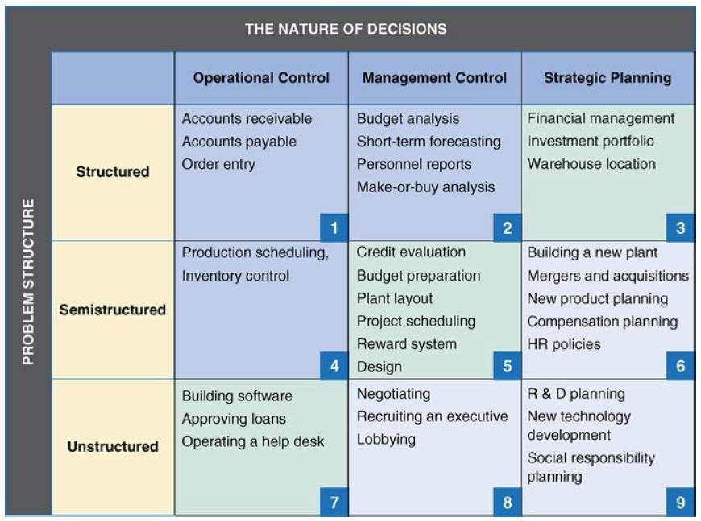
A Decision Support Framework

Slide 89
Managers and Decision Making
Lower-level managers usually perform the tasks in cells 1, 2, and 4.
Middle Managers & professional Staff perform the tasks in cells 3, 5, and 7
Senior Executives perform the tasks in cells 6, 8, and 9.
A Framework for Computerized Decision Analysis
Decision Matrix: Classes of problem structure and the three broad categories of the nature of decisions can be combined in a decision- support matrix that consists of 09 cells.
iii.

Slide 90
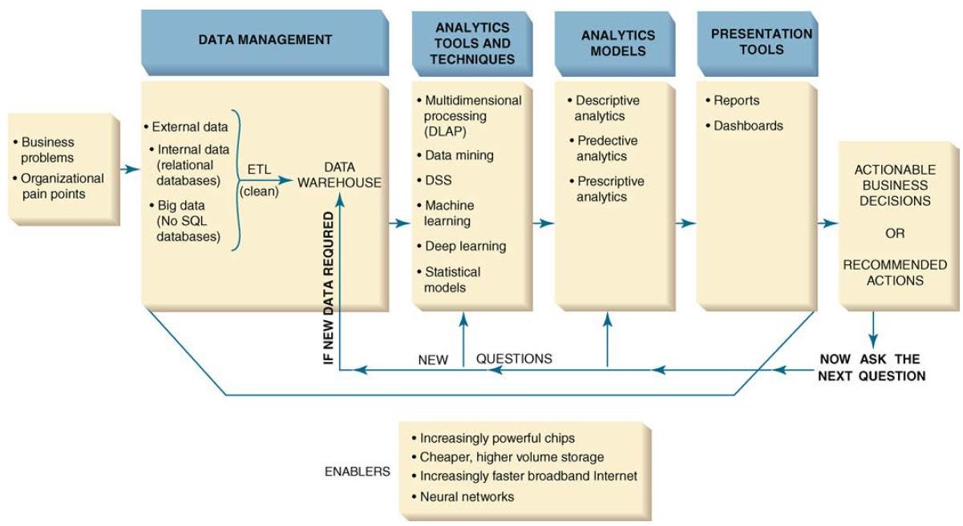
The Business Analytics Process

Slide 91
The Business Analytics Process
https://www.youtube.com/watch?v=VT8mSAwIJdM&feature=youtu.be
https://www.youtube.com/watch?v=0aHtHl-jcAs&feature=youtu.be https://www.youtube.com/watch?v=LFnewuBsYiY&feature=youtu.be
How the tools are helpful to the company?
How the BA process is supported?

Slide 92
The Business Analytics Process
The Scope of Business Analytics
Three specific analytics targets that represent different levels
of change.
These targets differ in terms of their focus; scope; level of sponsorship, commitment, and required resources; technical architecture; impact on personnel and business processes; and benefits.

Slide 93
The Business Analytics Process
The Scope of Business Analytics
The Development of One or a Few Related Analytics
Applications.:
For a departmental need, such as campaign management in
marketing.
Organizations usually create a data mart to store the data.
Care to be taken so that the data mart does not become a “data silo”.

Slide 94
The Business Analytics Process
The Scope of Business Analytics
The Development of Infrastructure to Support Enterprisewide
Analytics:
supports both current and future analytics needs.
crucial component of analytics is an enterprise data warehouse.
senior management often provides sponsorship, approval, and funding.
the impacts and benefits are felt throughout the organization.

Slide 95
The Business Analytics Process
The Scope of Business Analytics
Support for Organizational Transformation:
a company uses BA to fundamentally transform the ways it competes in the marketplace.
supports a new business model, and it enables the business strategy.
critical elements such as sponsorship, approval, and funding originate at the highest organizational levels.
The impact on personnel and processes can be significant, and the benefits grow across the organization.

Slide 96
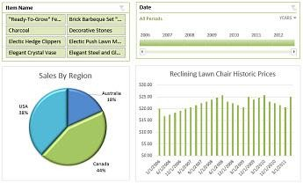
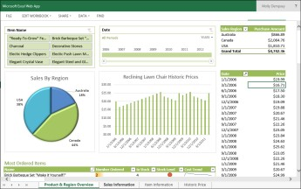
The Business Analytics Tools
1. Excel:
- BI capabilities available in Excel and SharePoint Online. These services enable you to gather data, visualize data, add filters, add
advanced analytic capabilities and share information with people in your organization across multiple devices.
https://support.content.office.net/en-us/media/46717093-ddc7-4fb5-aa0d-
57357429b160.jpg
https://support.content.office.net/en-us/media/273a7ab7-1f21-45ea-b86c-
4e1abf61bef7.png

Slide 97
The Business Analytics Tools
2. Multidimensional Analysis or
Online Analytical Processing:
also referred as online analytical
processing (OLAP).
it involves “slicing and dicing” data stored in a dimensional format, drilling down in the data to greater detail, and aggregating the data.
https://static.javatpoint.com/tutorial/datawarehouse/images/data-warehouse-what-
is-multi-dimensional-data-model4.png

Slide 98
The Business Analytics Tools
Data Mining:
The process of searching for valuable business information in a large database, data warehouse, or data mart.
Data mining can perform two basic operations:
predicting trends and behaviors - targeted marketing , forecasting bankruptcy etc.
identifying previously unknown patterns - analyze retail sales data to discover seemingly unrelated products that people often purchase together.
BA applications tell about what has happened; data mining explains
why it is happening, and predicts what will happen in the future.

Slide 99
The Business Analytics Tools
Data Mining:
can also be used to identify a business opportunity to create a sustainable competitive advantage.
Retailing and sales
Banking
Manufacturing and production
Insurance
Policework
Healthcare
Marketing
Politics
Weather

Slide 100
The Business Analytics Tools
4. Decision Support Systems(DSSs):
Combine models and data to analyze semistructured and some unstructured problems that involve extensive user involvement.
They enable business managers and analysts to access data interactively, to manipulate these data, and to conduct appropriate analyses.
They can enhance learning and contribute to all levels of decision making.
DSSs also employ mathematical models.
Finally, they have the related capabilities of sensitivity analysis, what–if analysis, and goal-seeking analysis, which are useful for any type of DSSs.

Slide 101
The Business Analytics Tools
4. Decision Support Systems(DSSs):
Blue Nile website has a built-in DSS to help customers find the diamond that best meets their needs.
https://www.bluenile.com/
Sensitivity Analysis – it examines how sensitive an output is to any change in an input while keeping other inputs constant.
What–If Analysis - predict the impact of changes in the assumptions (input data) on the proposed solution.
Goal-Seeking Analysis - “backward” solution approach. Goal seeking attempts to calculate the value of the inputs necessary to achieve a desired level of output.

Slide 102
Business Analytics Models
Data reduction is the conversion of raw data into a smaller amount of more useful information. Descriptive, predictive, and prescriptive analytics are essentially steps in data reduction.
1. Descriptive Analytics
The first step in data reduction and majority of business analytics are descriptive.
It summarize what has happened in the past and allow decision makers to learn from past behaviors.
Eg:- production, financials, operations, sales, finance, inventory, and customers.
- Fandango (www.fandango.com), the leading online ticket seller for movie theaters, wants to analyze the movie preferences of its customers during the past year.
112

Slide 103
Business Analytics Models
2. Predictive Analytics
Next step in data reduction.
It utilizes a variety of analytics techniques and tools to examine recent and historical data in order to detect patterns and predict future outcomes and trends.
Provides estimates about the likelihood of a future outcome.
Predicts multiple future outcomes.
Predictive analytics can only forecast what might happen in the future, because predictive analytics are based on probabilities.
Eg: How does the ticket seller know when to send e-mails to its members with discount offers for a specific movie on a specific day?

Slide 104
Business Analytics Models
3. Prescriptive Analytics
Recommends one or more courses of action and showing the likely outcome of each decision.
Prescriptive analytics attempt to quantify the effect of future decisions in order to advise on possible outcomes before the decisions are actually made.
Requires a predictive model with actionable data and a feedback system that tracks the outcome produced by the action taken.
Fandango example: The company uses prescriptive analytics to be able to change ticket price offerings every hour.

Slide 105
Business Analytics Models
Presentation Tools
After applying BA models, the results are presented to users in visual formats such as text, graphics, and tables. This is known as Data Visualization, makes
IT applications more attractive and understandable to users.
A. Dashboards
Provides easy access to timely information and direct access to
management reports.
It is user friendly, supported by graphics, and enables managers to examine exception reports and drill down into detailed data.

Slide 106
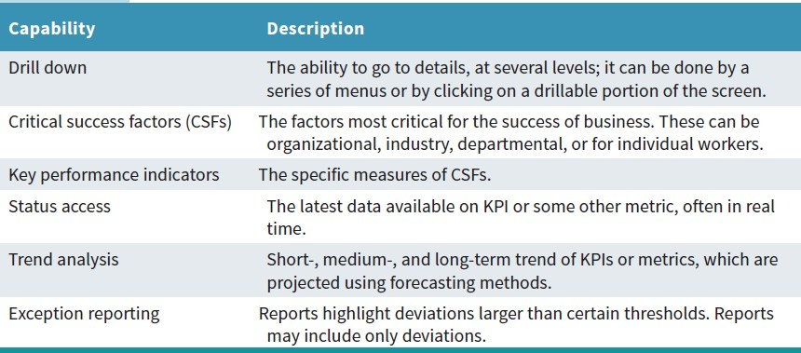
Business Analytics Models
The capabilities of Dashboards

Slide 107
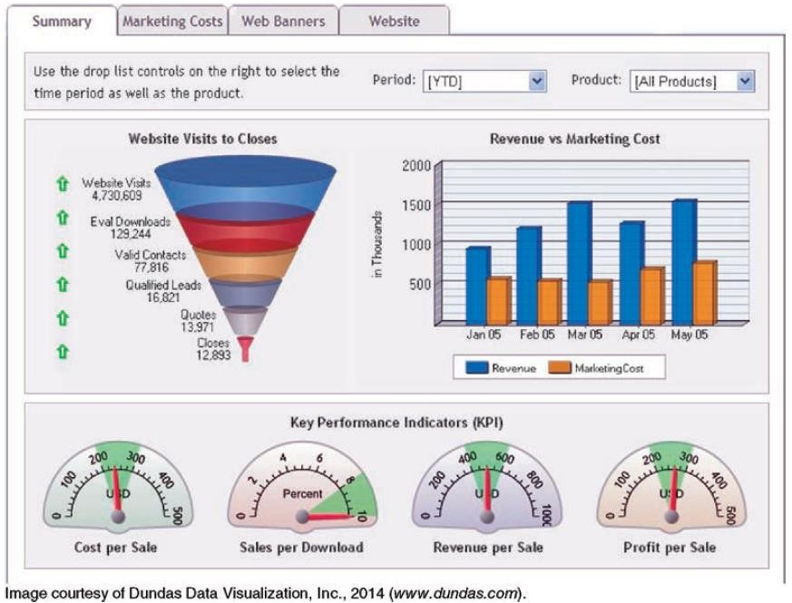
Sample Dashboard

Slide 108
Management Cockpit:
It is a strategic management room containing an elaborate set of dashboards that enable top-level decision makers to pilot their businesses better.
It encourages more efficient management meetings and boosts team performance via effective communication.

Slide 109
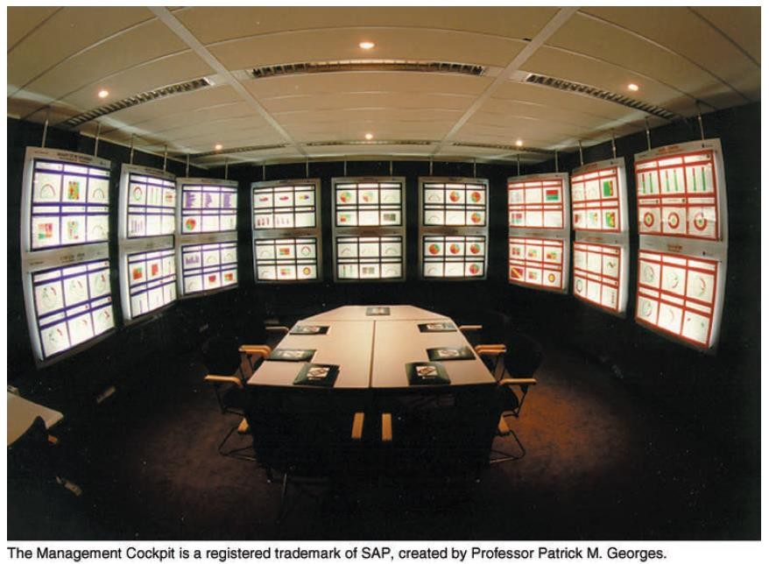
Management Cockpit:

Slide 110
Business Analytics Models
Presentation Tools
B. Geographic Information Systems
It is a computer-based system for capturing, integrating, manipulating, and displaying data using digitized maps.
Every record or digital object has an identified geographical location.
This process of geocoding, enables users to generate information for planning, problem solving, and decision making.
In addition, the graphical format makes it easy for managers to visualize the data.
Many applications of GISs to improve decision making in both the public and private sectors.
Children’s National Health System integrated its electronic health records system with GIS software from ESRI (www.esri.com) to display health data with geospatial coordinates.

Slide 111
Thank You!

